Slide 1

DRUG PERSISTENCY – EXPLORATORY DATA ANALYSIS
ABC PHARMA PROJECT
Group Name : SoloVision Analytics
Prepared By : Ankita Roy
Virtual Internship Program
Date : 16/06/25

Slide 2

PROBLEM DESCRIPTION
Drug persistency is a key metric in determining the long-term success of a treatment regimen. It reflects whether patients continue using a prescribed therapy as advised. Pharmaceutical companies like ABC Pharma often struggle to identify the factors that cause patients to discontinue treatment.
To address this, ABC Pharma has sought the help of data science to automate the detection of persistency patterns among patients using their drug. The aim is to develop a classification model that predicts whether a patient is likely to persist with the treatment based on demographic, clinical, and behavioural data.
The binary target variable for this task is Persistency_Flag, where the goal is to classify patients as either persistent or non-persistent.

Slide 3
DATASET OVERVIEW
3424 number of rows with 68 features
Features cover Demographics, Clinical Factors, Physician Details, Treatment Usage, Adherence etc.
Target variable : Persistency Flag (Persistent vs Non-Persistent)
No missing values
No duplicates as well
Each record = Unique patient ID

Slide 4
UNIVARIATE ANALYSIS : TARGET VARIABLE

Slide 5
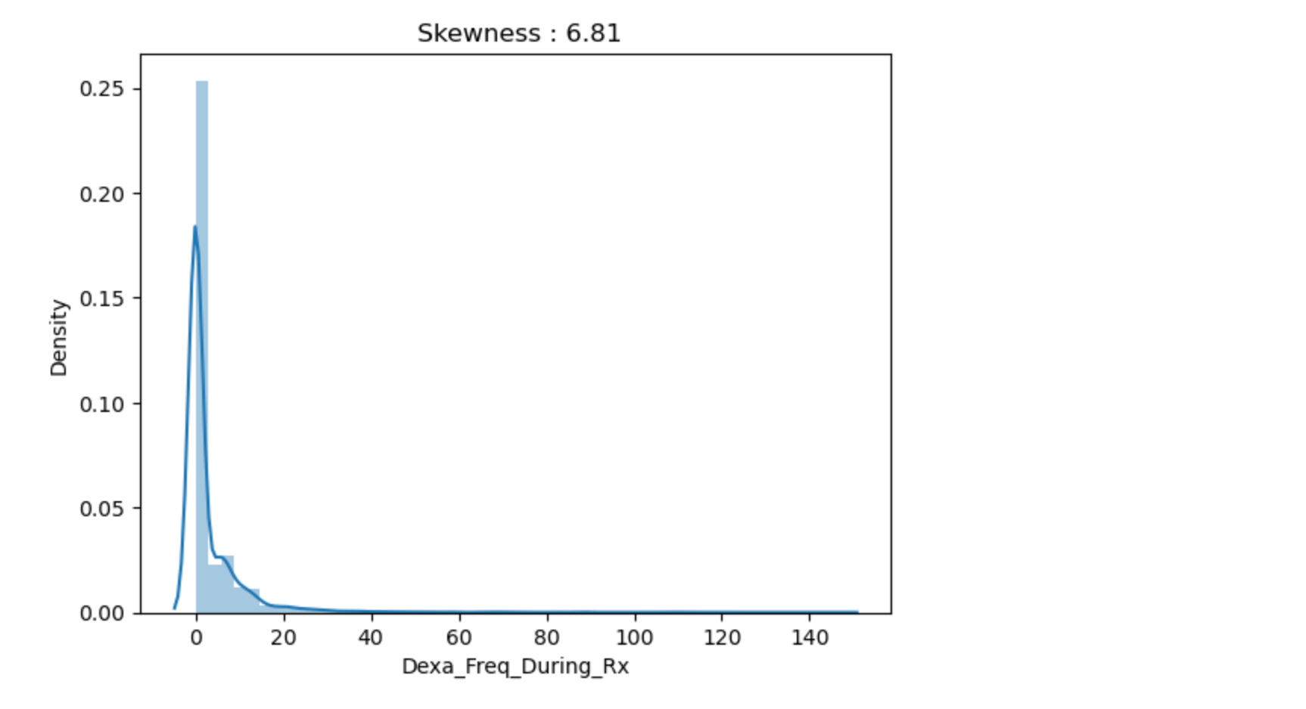
UNIVARIATE ANALYSIS : NUMERICAL COLUMN

Slide 6
UNIVARIATE ANALYSIS : CATEGORICAL COLUMNS

Slide 7
UNIVARIATE ANALYSIS : CATEGORICAL COLUMNS

Slide 8
UNIVARIATE ANALYSIS : CATEGORICAL COLUMNS

Slide 9
BIVARIATE ANALYSIS : NUMERIC VS TARGET

Slide 10
BIVARIATE ANALYSIS : CATEGORY VS TARGET

Slide 11
BIVARIATE ANALYSIS : CATEGORY VS TARGET

Slide 12
STATISTICAL TEST SUMMARY
Shapiro – Wilk Test : Not normal
Levene’s Test : Unequal variance
Mann-Whitney U Test : It says patient’s who are persistent tend to have more Dexa scans during Rx
Conclusion : Dexa scan frequency is statistically relevant

Slide 13
KEY FINDINGS AND BUSINESS INSIGHTS
Mild class imbalance
Dexa scan frequency has predictive value
Certain demographics dominate like female, Caucasian race etc.
These factors may influence targeting or interventions

Slide 14
TECHNICAL RECOMMENDATIONS
Suggested next steps are:
Try Logistic regression as baseline model
Ensemble techniques like Random Forest, Gradient Boost, XG Boost for performance and feature importance
Monitor metrics : Accuracy, Precision, Recall, ROC
Consider resampling or class weights for imbalance if needed
Possible deployment : Pickle

Slide 15
KEY TAKEAWAYS
EDA shows mild class imbalance, important predictors (e.g., Dexa scan frequency), and clear patient patterns
No missing values or duplicates; outliers addressed – dataset is clean and ready for modelling
Next : Train test split, build, tune & deploy classification models to predict Persistency Flag and support ABC Pharma’s business goals

Slide 16
THANK YOU

